Slide 1

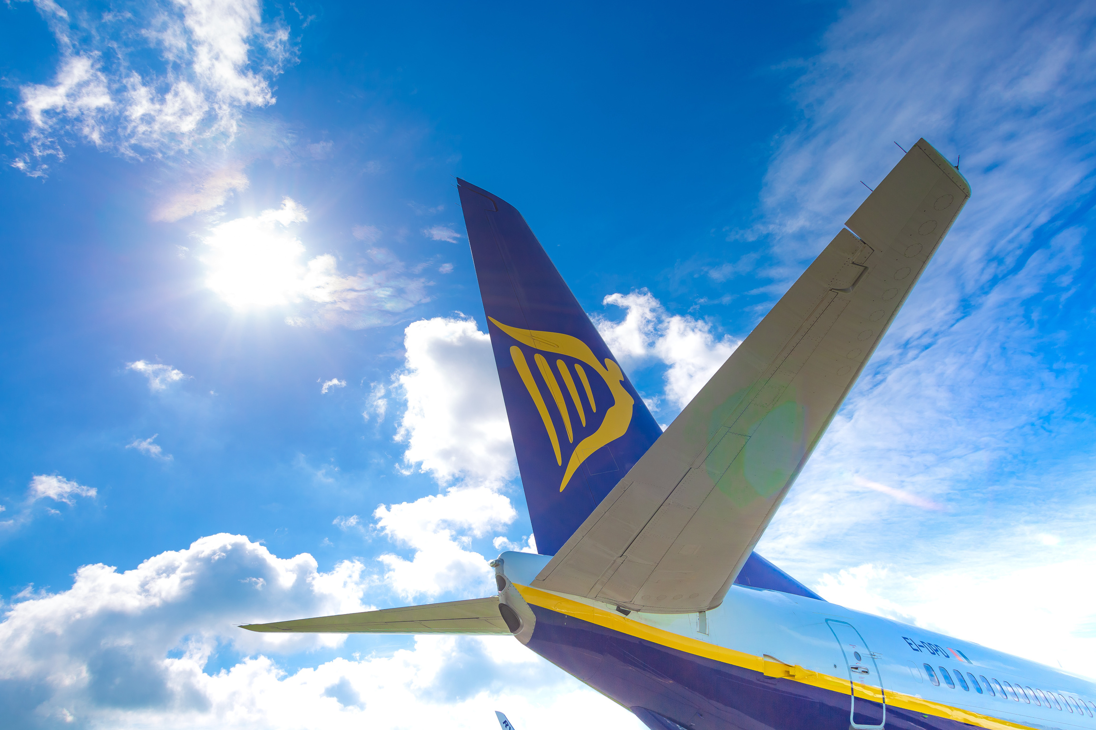
ASL OPEN PROJECT • GOOGLE CLOUD • GENAI AGENT
Predictive-Maintenance Agent
PMA
Spot a component's precursor symptom in a new work order, and predict the flight cycles until it needs replacing - turning unscheduled maintenance into planned.
Team: Sebastian Kulaga ( AI/ML Engineer ) · Nicolas Silva ( BI Data Engineer ) · Adrian Pozueco (Principal Software Engineer )
Scope: Boeing 737-800 NG / 737-8200 MAX Stack: ADK · Gemini on Agent Platform · BigQuery · Agent Platform Search
Date: September 2026
Notes:
~0:30. The pitch: today a component often gives an early warning in a work order, then fails some flight cycles later - and that precursor signal is ignored. We built an agent to catch it and predict the lead time so planners act early. Introduce the three of us; Sebastian runs the demo. PACING (~20 min): title 0:30 · problem 2:30 · dataset 2:30 · solution 3:30 · process 2:30 · DEMO 3-5 min · production 2:00 · summary 1:30. Trim content if the demo runs long.

Slide 2
01 · PROBLEM & LEARNING GOALS
Unscheduled maintenance is costly - the warning is already there
The problem
The opportunity & impact
- Unscheduled work is disruptive. AMOS tracks every work order with the aircraft's flight cycles.
- A precursor usually appears first. A symptom is recorded in a WO, then the part is replaced some cycles later.
- That signal is unused today. Nobody connects the early symptom to the later replacement.
✓ Event-driven prediction - on each new WO, recognise a known precursor pattern.
✓ Cycles-to-replacement - estimate how long until the component likely fails.
✓ Plan, don't react - convert unscheduled events into scheduled ones; fewer AOGs.
Feasibility
Learning goal
- Managed GCP building blocks - BigQuery, Agent Platform Search, Agent Runtime; no bespoke infra.
- Recommendation-only - the agent advises; engineers keep the decision.
- Scoped to one fleet - 737-800 NG / 737-8200 MAX keeps data and evaluation tractable.
→ Use RAG over historical WOs to find semantically similar precursor cases
→ Measure the flight cycles between that precursor and the replacement
→ Project the lead time as a distribution with confidence (p50 / p90)
Domain terms: AMOS = maintenance ERP · WO = work order · flight cycle = one take-off+landing · precursor = early symptom before a failure · P/N = part number · NG = 737-800 · MAX = 737-8200.
PMA · Predictive-Maintenance Agent · ASL Open Project
2
Notes:
~2:30. State the problem in the team's own words: unscheduled maintenance is costly; a failure usually shows an early symptom in a work order, then the replacement happens some cycles later; that precursor link is not exploited today. The opportunity: an event-driven agent that predicts cycles-to-replacement so planners act early. Feasibility: managed GCP + advisory-only. Then read the learning goal - RAG over WOs, measure elapsed cycles, project a lead-time distribution.

Slide 3
02 · DATASET
AMOS work orders, plus public FAA reports
8,259
196,404
31,677
211
AMOS work orders parsed
FAA SDR reports (2023-25)
Boeing 737 subset
fields in the WO schema
Sources, features & labels
Preprocessing & privacy
- AMOS work-order XML - flight cycles, part in/out; nested schema.
- Feature - embedding of the WO symptom text for semantic similarity.
- Label - confirmed replacement + flight cycles elapsed (the lead time to learn).
FAA SDR (public) - cracks, corrosion, hydraulic leaks, electrical & cabin faults; narratives + cycles. ( potentially extension )
Add the manual
→ XML → NDJSON (scripts/xml_to_ndjson.py) with generated BQ schema + drift check.
→ Anonymise aircraft registrations; keep any mapping out of the index.
→ FAA filter (build_faa_sdr_wo_parts.py) → Boeing WO-part matches only.
→ Separate sources - a public FAA report is never joined into an aircraft's own history.
Why two datasets
- AMOS is the outcome truth - real fleet histories with the precursor → replacement pairs we predict on.
- FAA is breadth for retrieval - 31,677 Boeing 737 reports enrich the symptom vocabulary while we build the AMOS pipeline.
PMA · Predictive-Maintenance Agent · ASL Open Project
3
Notes:
~2:30. Lead with the metrics. Two datasets, two jobs: AMOS work orders carry the ground truth - the precursor symptom and the later replacement with the flight cycles between them (that gap is our label). FAA SDRs are public breadth for the retrieval vocabulary. Preprocessing highlights: the 211-field nested XML needs an explicit generated schema; we anonymise aircraft registrations; AMOS and FAA stay in separate tables.

Slide 4
03 · SOLUTION OVERVIEW
Two cooperating agents: build knowledge offline, decide online
OFFLINE
ONLINE
Agent 1 · Knowledge Builder
Agent 2 · Decision Agent
→ Ingest historical AMOS work orders.
→ Detect confirmed component replacements.
→ Find precursors Pipeline: SQL filters → semantic similarity → LLM adjudication.
→ Publish trusted artifacts - embeddings · precursor→replacement links · TAC lead-time (p50 / p90 / confidence).
→ Trigger on each new AMOS work order (event-driven).
→ Embed the new work-order text.
→ Retrieve the closest precursor patterns from Agent 1's index.
→ Recommend risk + expected flight cycles to replacement - advisory only.
index
Why split them? Rigorous validation in batch + fast, low-latency decisions at runtime.
On Google Cloud
BigQuery (WO tables, embeddings, vector search, lead-time SQL) · Agent Platform Search (IPC manuals / grounding) · Agent Runtime + Gemini (hosting, adjudication, generation) · Cloud Storage · Cloud Run · Logging + Trace → BigQuery · Terraform (IaC) · A2A protocol
PMA · Predictive-Maintenance Agent · ASL Open Project
4
Notes:
~3:30 (the core slide). The design is two cooperating agents. Agent 1, Knowledge Builder, runs offline: it mines AMOS history, confirms real replacements, and uses the L0-L3 pipeline (SQL filters, then semantic similarity, then LLM adjudication) to find genuine precursors - publishing embeddings, precursor→replacement links and TAC lead-time distributions. Agent 2, Decision Agent, runs online: a new work order triggers it, it embeds the text, retrieves the closest precursors from Agent 1's index, and returns a risk + expected-cycles recommendation. The split buys quality (batch validation) and speed (runtime). Everything sits on managed GCP, provisioned by Terraform.

Slide 5
LIVE DEMO
Upload a work order - watch it respond
1
2
3
4
Upload
Read
Retrieve
Respond
.xml work order into the web app
symptom + flight cycles extracted
similar precursor cases / part info
cited answer + expected lead time*
Today's demo: the online agent identifies a part from the work order and answers with citations.
*Lead-time prediction is the in-progress capability - shown as the target output.
Notes:
3-5 min (centrepiece - give it room). Hand to Sebastian; keep a recorded fallback ready. Show the real, working path: upload a work order, the agent reads it, retrieves, and returns a cited answer (the part lookup with its Citations block is the trust story). Be upfront that the cycles-to-replacement number is the target output we're building toward, not yet live - don't fake it. Keep to one or two clean examples.

Slide 6
04 · TAKING IT TO PRODUCTION
From a working foundation to a deployed service
ML Roadmap · LLM labels → classical ML
1
2
3
Clean the data
Get human labels
Rules, then ML
Dedupe candidates · keep LLM verdicts · deterministic queries
SME sets: precursor pairs, removal reasons, chat questions
Rule baselines first · BQML logistic regression where rules plateau
Why not ML today: 30 positive labels, 29 from one component, noisy LLM verdicts · Top-20 rebuild adds ~3.5× replacements (718 → 2,566 WOs).
PMA · Predictive-Maintenance Agent · ASL Open Project
7
Notes:
~2:00. The path from foundation to production. The big pieces: finish the Knowledge Builder (precursor + lead-time model, carefully labelled, no leakage), finish the analytics tools, and add the event trigger so a new AMOS work order actually fires the Decision Agent. Then grant the runtime BigQuery access, eval-gate, and deploy to Agent Runtime. Right column maps each production need to a specific GCP service - answering the ASL 'which services in production' question.

Slide 7
05 · SUMMARY
Key lessons and where we go next
Lessons learned
GCP we'll take forward
✓ The signal is in the history - precursor → replacement is a real, learnable pattern in AMOS.
✓ Split offline / online - validate rigorously in batch, decide fast at runtime.
✓ Real schemas are the hard part - 211 nested WO fields drove most of the data work.
✓ Ground everything - citations turn an LLM answer into something engineers trust.
✓ IaC + telemetry from day one - Terraform and tracing paid off immediately.
→ BigQuery - embeddings, vector search and lead-time SQL in one place.
→ Agent Platform Search - grounded retrieval with metadata filters.
→ Agent Platform butRuntime + Gemini - managed hosting, routing, generation.
→ Eventarc / Pub-Sub - the event-driven trigger for online decisions.
→ Terraform + Cloud Trace - reproducible infra and built-in observability.
References: Ryanair maintenance reports - Forecast Check · non-effective Part Number Analysis & Validation · Kestrel – AMOS Work Order.
Catch the precursor, predict the lead time - turn unscheduled maintenance into planned. Thank you - questions welcome.
8
Notes:
~1:30. Land the lessons: the precursor→replacement signal is real and learnable; the offline/online split gives both quality and speed; the nested AMOS schema was the real difficulty; grounding and citations build trust. List the GCP services we'll keep. Note the Ryanair reference reports. Close on the one-line thesis and open for questions. Total ≈ 19 min + demo, leaving buffer for Q&A.

